Slide 1

Hurricane Research at AOML & NOAA
Frank Marks

Slide 2
Vision
Laboratory Review 2019
HRD Presentation
Advance understanding and prediction of tropical cyclone track, intensity, and structure change and their impacts through observations, numerical models, and theory
NOAA’s hurricane research focus for >60 years

Slide 3

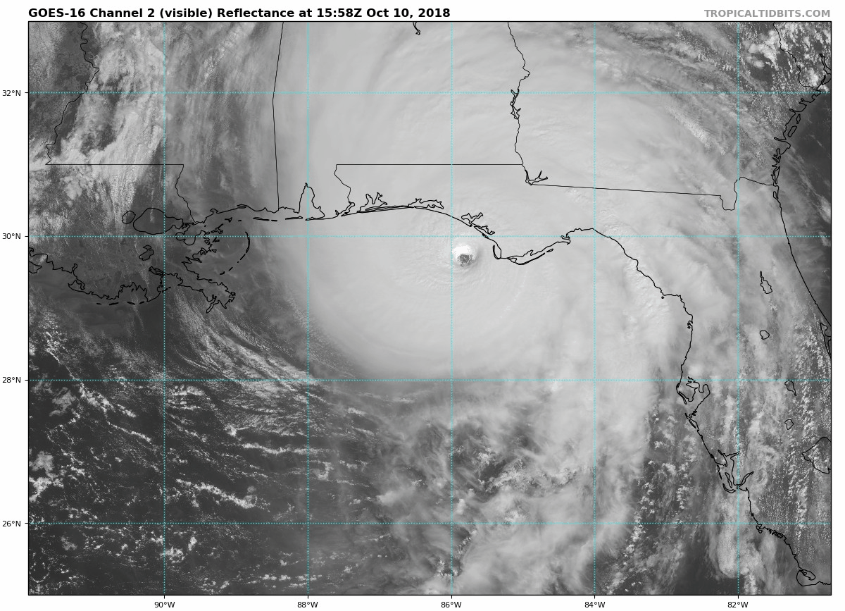

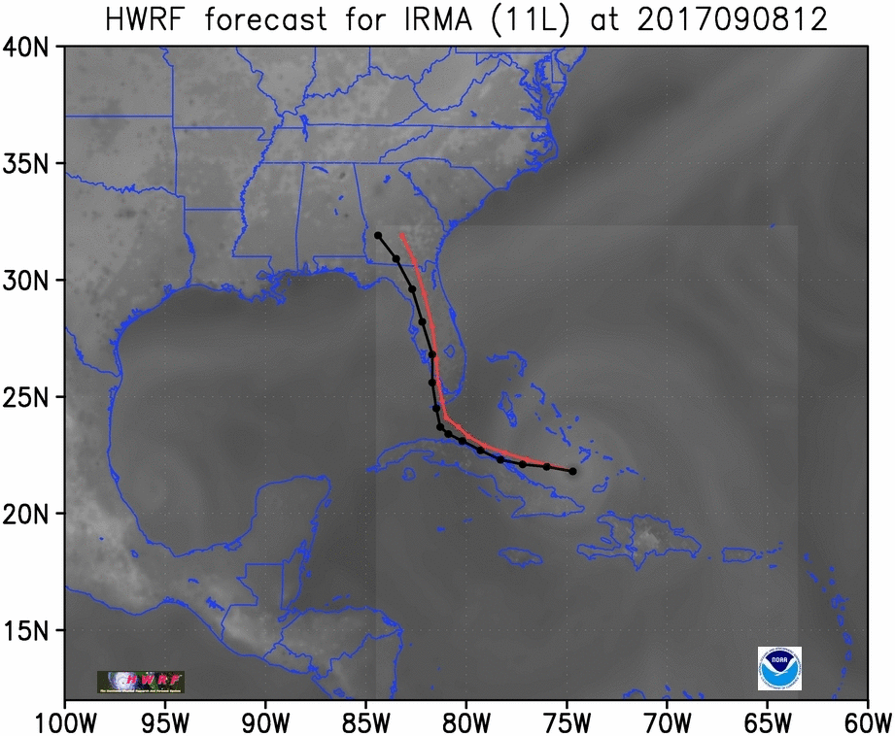
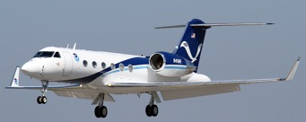
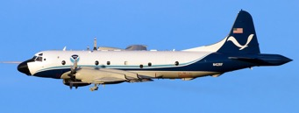
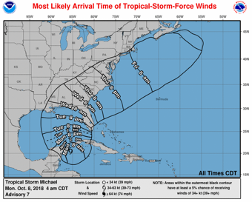
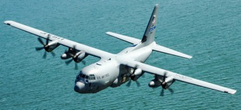
Mission
Understanding & prediction of TCs
Observations (aircraft, satellite)
FACETs
Analysis systems (DA)
Models (HWRF, HAFS)
Observing strategies (e.g., OSE/OSSE)
Evaluation (e.g., parameterizations)
Notes:
Advance understanding and prediction of TCs through observations, numerical models, and theory, with emphasis on processes within inner part of storm. HRD research supports AOML and NOAA's Strategic Plan:
Goal 1: Characterize, understand, and predict physical processes important to prediction of TC track, intensity, and structure change and their impacts.
Goal 2: Optimize the use of current and proposed observations to improve global and TC forecast guidance.
Goal 3: Advance TC forecast guidance by creating and verifying the next generation numerical models, and advancing DA techniques in support of NOAA’s UFS.
NOAA’s hurricane research focus for >60 years

Slide 4
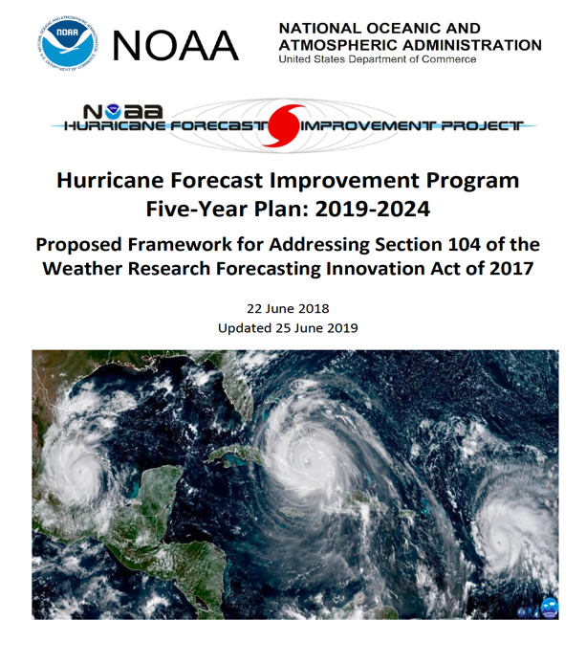
Hurricane Forecast Improvement Program
Unified approach to guide & accelerate forecast improvements
  improve prediction of rapid intensification & track
  improve forecasts & communication of storm hazards
  incorporate risk communication research to create more effective products
http://www.hfip.org

Slide 5
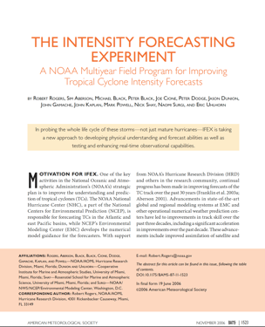
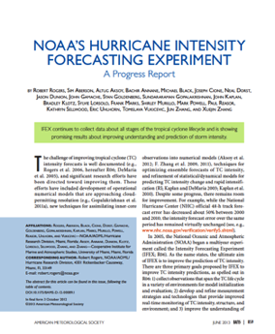
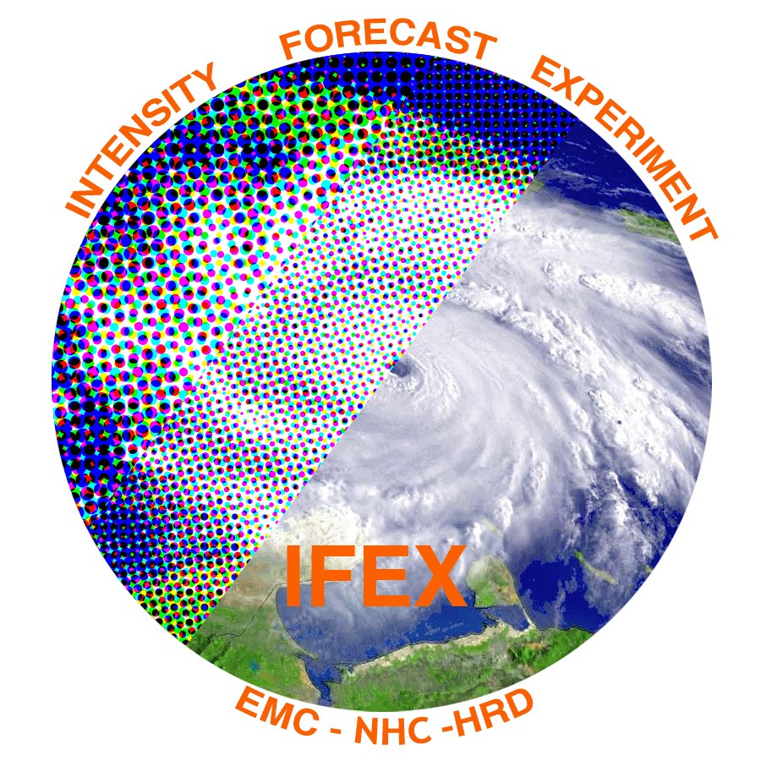
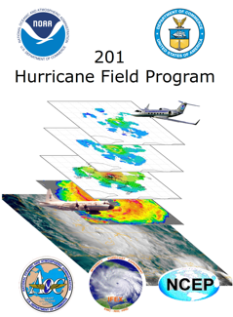
NOAA Intensity Forecast Experiment (IFEX)
Collect observations over TC life cycle for model initialization & evaluation
Develop measurement technologies to provide improved monitoring of TC intensity, structure, & environment
Improve understanding of processes important in intensity change
9
Rogers et al., BAMS, 2006 & 2013
Notes:
• AOML/HRD provides operational support for G-IV surveillance (2 people) and WP-3D reconnaissance SFMR (1 person) missions despite transitioning activities to operations. HRD augments AOC staff by providing meteorological expertise for data QC.

Slide 6
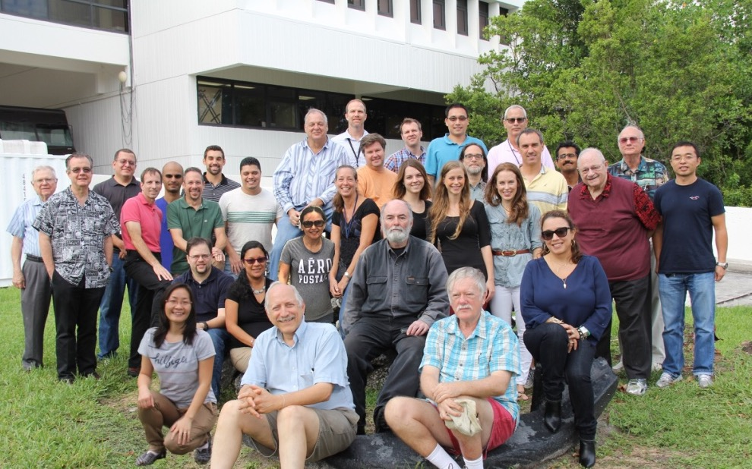
HRD by the Numbers: Personnel
24 scientists
28 science support
35% under-represented minorities

Slide 7

Activities & Collaborations
EMC
AOC
JEDI
UFS
NCAR
AI/ML
PhOD
AWIPS-II
NESDIS
FACETs
NHC
NOSC

Slide 8


































Stakeholders
OMAO

Slide 9
HRD by the Numbers: FY 2019 Productivity
40
20
30
Publications
Transitions
Proposals

Slide 10
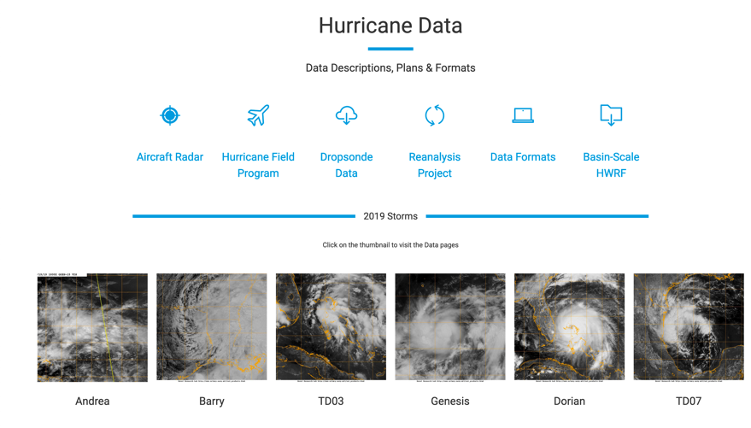
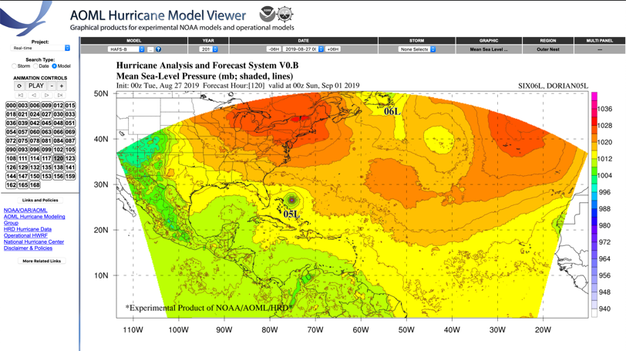
HRD by the Numbers: Products
15,146 Users
10
AOML Program Review
Notes:
10
Data Sets:
HRD Data Policy requests data set users register and to list which data sets they are interested in:
We currently have ~15100 users registered that access our data sets and the breakdown of the data sets they are interested in is presented.
We added our model data sets to the list of data available in 2013 and are now going to track their access as well

Slide 11
HRD by the Numbers: Budget
FY 2019
$7.0M
Funding
Proposals
=
$3.9M
Base funds
Base funding
+
$3.1M
30 Proposals
Notes:
Supports NOAA's Strategic Plan: Weather Ready Nation
HRD Budget:
Prior to 2008 base was ~$3.9M of which HRD received ~$3M to spend
2006 – Non-base increase included $1.28M of which $284K was reimbursement for manpower and expendable costs incurred in FY05 flying in support of operational missions in Katrina, Rita and Wilma. The remaining $1M went to AOML for repairs of the damage from Katrina and Wilma landfalls in FL and for hardening of the facility.
2008 –Increase to base in 2008 for OAR hurricane research was $2M of which HRD received $1.4M raising HRD base to $5.3M which is highlighted in light green
2009 – HFIP started in 2009 and HRD received from NWS $1M in support of HFIP operational efforts with HWRF which is highlighted in light blue
2014 – HRD received a one-time increase of $1.8M in non-base support from Sandy Supplemental which is highlighted in darker blue; Begin OSSE support of $500K-$800K
2015 – CR with .05% cut and end of federal Sandy support; QOSAP begins providing ~$800K
2018 – CR with 1.9% rescission
2019 – HRD received a one-time increase of $1.2M in non-base support from Hurricane Supplemental, plus ~$450K one-time non-base OAR UFS Gap support and ~$600K NESDIS/NWS/OMAO OSSE support

Slide 12









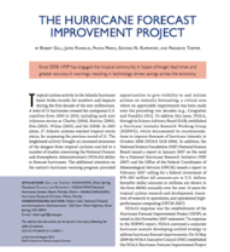


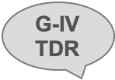








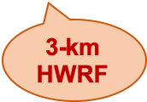
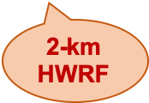
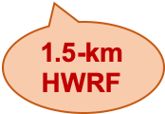


Research Advancements
Observations
2005
2008
2011
2014
2017
2019
Prediction

Slide 13
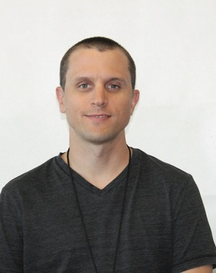

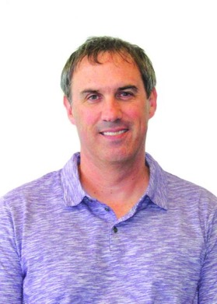
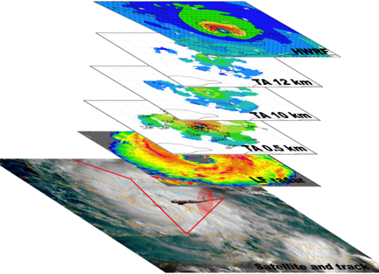
Major Research Areas
Characterize, Understand, & Predict Processes Important to Prediction of TCs and their Impacts
Jon Zawislak
Jason Dunion
Robert Rogers
Tropical Cyclone
Observations from
NOAA’s Hurricane
Field Program
New technologies for real-time monitoring of tropical cyclone intensity, structure, and environment
Airborne observations
to better characterize and understand physical
processes in tropical cyclones
Notes:
https://www.aoml.noaa.gov/our-research/hurricane-research-division/hurricane-field-program/

Slide 14
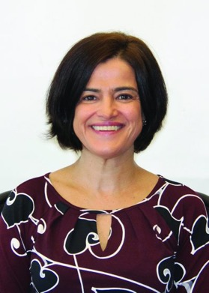
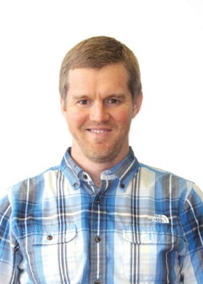
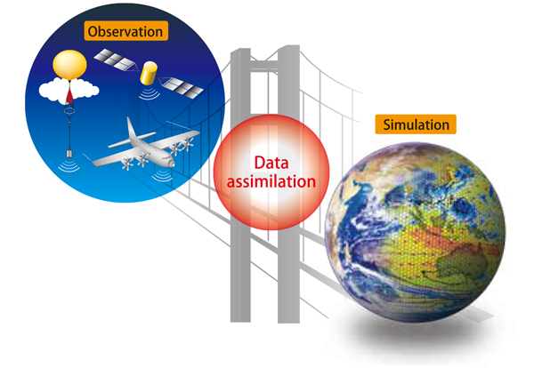
Major Research Areas
Optimize use of Observations to Improve Forecast Guidance
Lidia Cucurull
Jason Sippel
Optimizing observing
system strategies for
tropical cyclone
applications
Leveraging partnerships to improve assimilation of
reconnaissance data

Slide 15

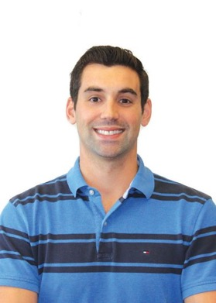

Major Research Areas
Advance Hurricane Forecast Guidance
S. Gopalakrishnan
Gus Alaka
Advances in Tropical
Cyclone Forecast
Modeling Systems
Advances in Research
Transitions and Model
Evaluation

Slide 16
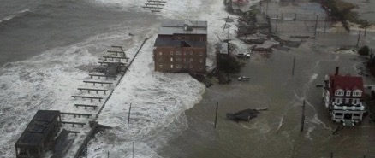
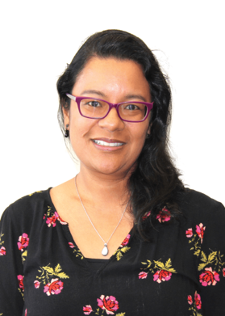
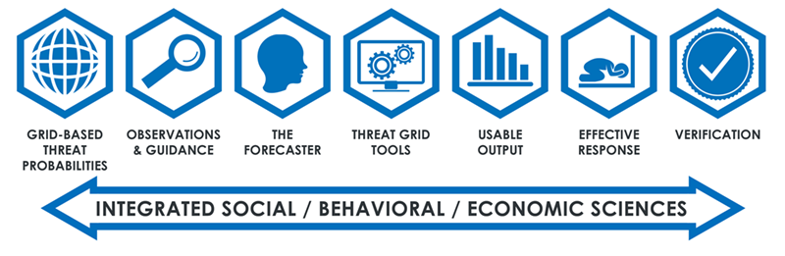
Emerging Research Areas
Impacts
Shirley Murillo
Partnerships supporting
transitions to operations

Slide 17
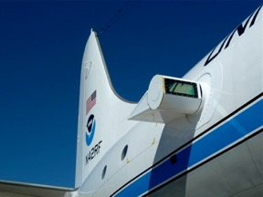

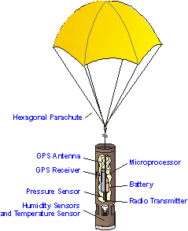

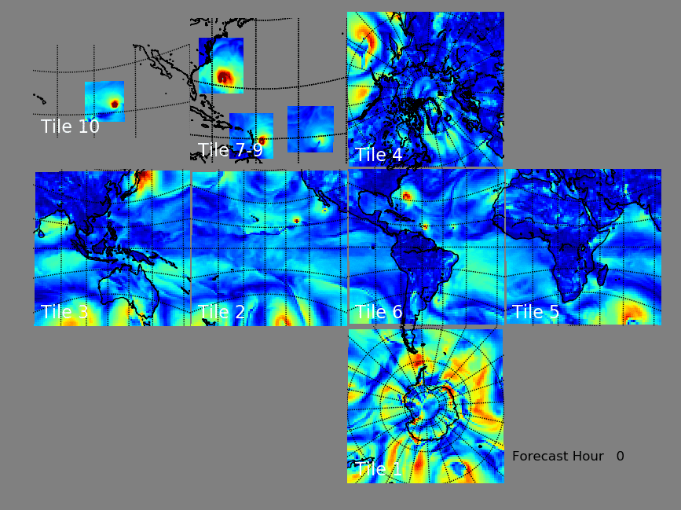
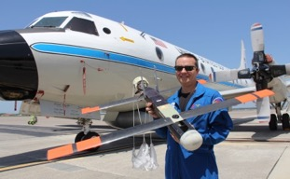

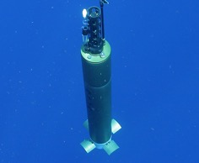
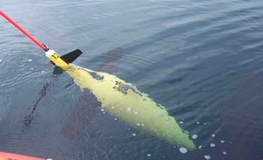
Emerging Research Areas
DWL
SST
Dropsonde
sUAS
Coupled DA
HAFS
UFS
Gliders
ARGO Floats

Slide 18
Challenges
Balance long-term basic research with short-term R2O applications
Consistent, stable, year over year “base” support to advance existing TC research capabilities
Talent recruiting/retention
Observing Cost (flight hours, expendables, personnel)
High Performance Computing access
Data management

Slide 19
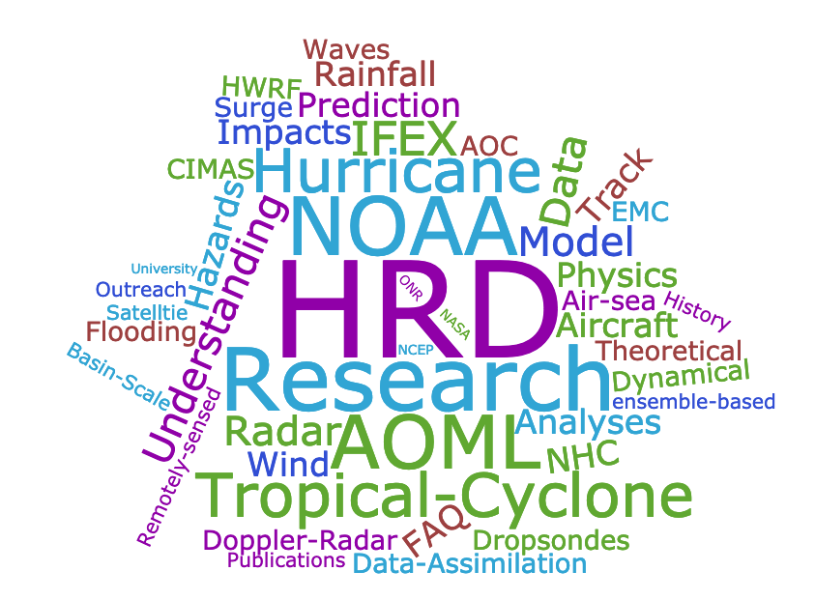
Thank you!
HWRF
Satellite
HAFS

