Slide 1
AOML Lab Review: The Foundation To Research Success
Gary Matlock, Ph.D.
Deputy Assistant Administrator for Science
Office of Oceanic & Atmospheric Research
November 19, 2019
Notes:
OAR views Lab Reviews as a foundational activity that’s critical to successful lab research planning and execution.
As I’ll show in a moment, AOML has a long history of science success.We have been doing Lab reviews for a decade plus – this is AOML’s third review.
OAR has found the reviews to be very successful in highlighting world leading science, and somewhat successful in helping lab directors make strategic decisions about how to change their portfolios following a review.
To ensure that you, the review panel, are successful at both tasks, I’ll be setting the stage for the review with Dr. Wayne Higgins following me to explain how AOML fits into OAR’s three science portfolios.
Then Dr. John Cortinas will follow these corporate perspectives with his lab overview.

Slide 2
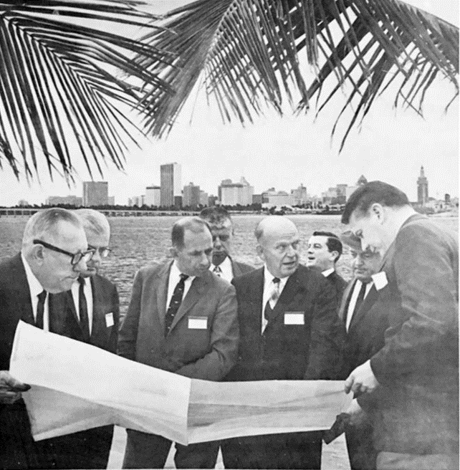
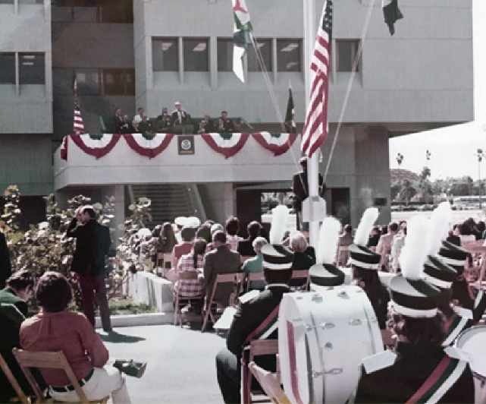
AOML history
NOAA’s precursor, the Environmental Science Services Administration (ESSA), made a decision to put a national laboratory and a ship base somewhere on the East Coast.
Notes:
AOML’s history of scientific success traces back to NOAA’s predecessor, the ESSA.
In 1967, Miami was selected out of more than 120 sites and the initial process began. The ESSA broke ground in 1970 and the future AOML opened its doors in 1972 with Harris Stewart as the first director.
AOML has since dedicated its resources building one of the most prolific research profiles on coastal and ocean science.
In addition, we have hosted and been home to scientists who have contributed greatly to our field, including some who are still pushing the boundaries of our science today.

Slide 3
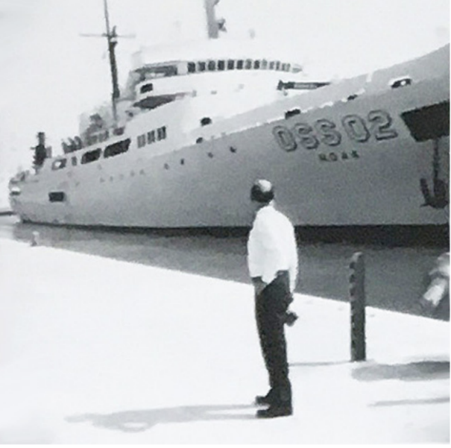
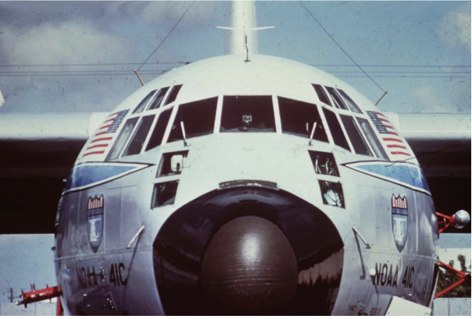
The Evolution of AOML
AOML has evolved from 3 labs - Marine Geology and Geophysics, Physical Oceanography, and Sea-Air Interaction – to include the National Hurricane Research Laboratory and an Ocean Chemistry Lab
Notes:
Since 1981, all “Laboratories” became “Divisions” under the name Atlantic Oceanographic and Meteorological Laboratory – AOML.

Slide 4
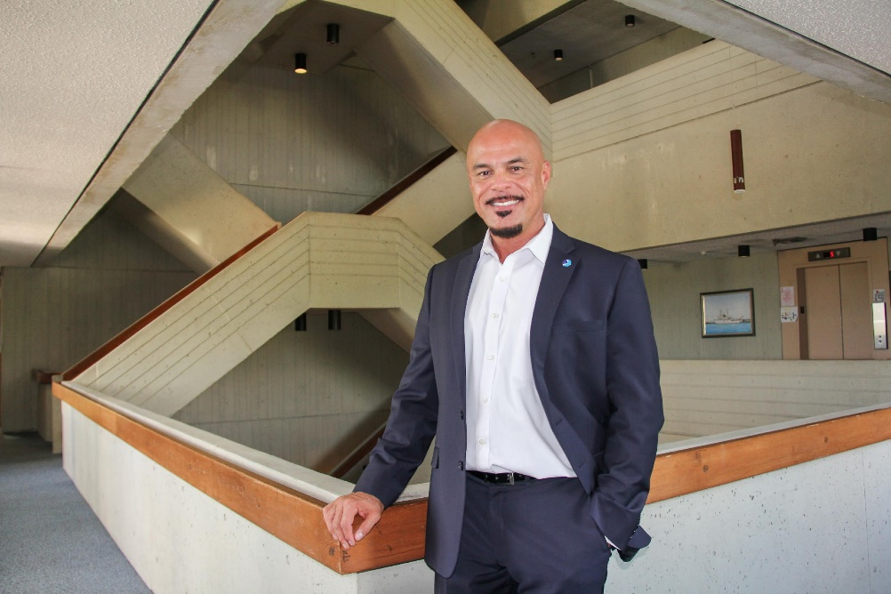
AOML Leadership
On July 8th, 2018, John Cortinas, Ph.D. became the 5th permanent director of AOML.
2005 – 2019: Robert Atlas, Ph.D.
1997 – 2003: Kristina Katsaros, Ph.D.
1980 – 1997: Hugo F. Bezdek, Ph.D.
1967-1978: Harris B. Stewart, Ph.D. Founder & First Director
Notes:
Outstanding leadership is necessary to put OAR’s Strategic Vision into action through the science the lab conducts.

Slide 5
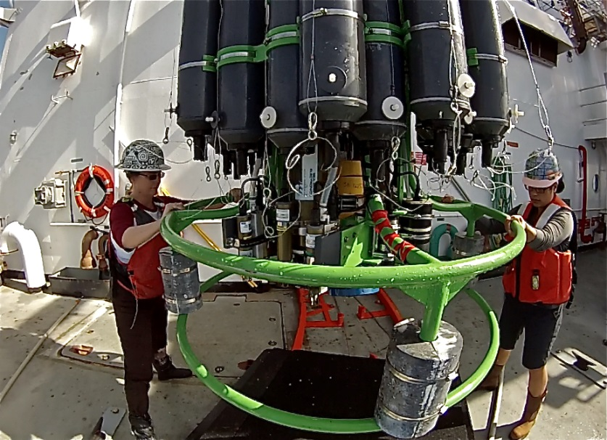
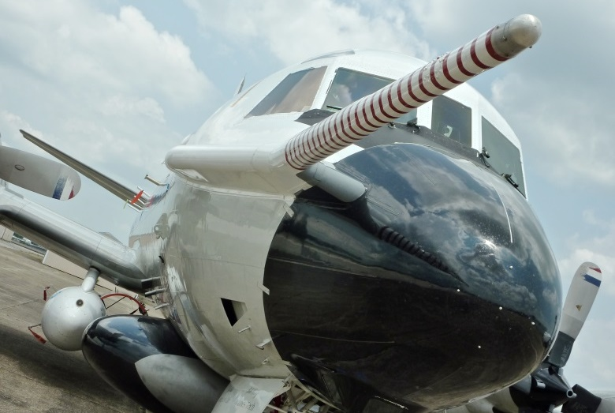
OAR’S VISION & MISSION
Conduct research to understand and predict the Earth system; develop technology to improve NOAA science, service, and stewardship; and transition the results so they are useful to society.
.
Deliver NOAA’s Future
VISION
MISSION
Notes:
OAR’s role is to provide unbiased science to better manage the environment, nationally and globally. Our role within NOAA is to provide products and services that describe and predict changes in the environment.
Research results allow decision makers to make effective judgments in order to prevent the loss of human life and conserve and manage natural resources while maintaining a strong economy.
Vision Image: AOML Deputy Molly Baringer and Survey Tech Darcy Balcarce recover CTD/NOAA ship Ronald H. Brown/CLIVAR2013 Iceland to Madeira.
Mission Image: A primary mission of this aircraft--a hurricane hunter--is taking measurements in hurricanes to improve predictions and scientific understanding. But these photos were taken during the Southeast Nexus (SENEX) research study of air quality and climate in the Southeastern United States. The aircraft was the centerpiece of the study--filled with scientific instrumentation to analyze gases and small particles. This photo was taken in Smyrna, Tennessee.

Slide 6
OAR’s Corporate Values
Commit to Diversity
Explore to Solve
Uphold Scientific Integrity
Engage from Local to Global
Notes:
OAR’s Corporate Values flow through everything we do. They help us keep pour mission and vision aligned with our goals, our stakeholders, our research partners, and NOAA’s corporate requirements.
Commit to Diversity- OAR is enriched by diverse perspectives, celebrating each other’s unique experience and expertise.
Explore to Solve - OAR is dedicated to advancing science, making discoveries, and investing in the end-to-end process to deliver results.
Uphold Scientific Integrity - OAR is resolute in its commitment to scientific truth and how it is conveyed.
Engage from Local to Global - OAR is involved locally and internationally to understand the changing environment and inform the public.

Slide 7
OAR Goals Looking Ahead (2020-2025)
Notes:
AOML will need to be responsive to these Goals over the next 5 years.
Your evaluation of how successful they have been in meeting OAR”s prior strategic Goals will guide the choices they make.

Slide 8
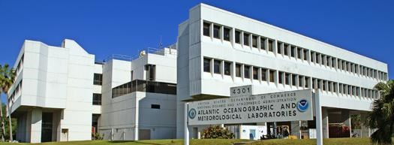
HOW OAR USES YOUR REVIEW
Assist labs in strategically planning future science
Maintain consistency with NOAA strategic planning, budgeting & execution
Recognize lab scientists’ leadership excellence & contributions in research fields
Identify equipment & facility challenges that hinder success
Locate communication strengths & weaknesses between labs/offices/ leadership
Notes:
This review is useful both for internal OAR/NOAA planning, programming, and budgeting, and for the laboratory’s strategic planning of its future science. These reviews should also ensure that OAR research is relevant to NOAA’s research mission and OAR corporate priorities, of high quality as judged by preeminence criteria, and carried out with a high level of performance.

Slide 9
CHARGE TO REVIEWERS
QUALITY: Assess quality of lab’s R&D
RELEVANCE: Assess lab’s R&D relevance to NOAA’s mission & value to Nation
PERFORMANCE: Assess overall effectiveness of lab’s plans & R&D in meeting NOAA’s Strategic Plan objectives & Nation’s needs
Notes:
Quality: Evaluate the quality of the Laboratory’s research and development. Quality is a
measurement of merit within the scientific community based on the novelty, soundness, accuracy, and reproducibility of a specific body of research, as represented by outputs delivered by the Laboratory.
Relevance: Evaluate the degree to which the Laboratory’s research and development is
relevant to NOAA’s and OAR’s missions and of value to the Nation. It is a direct expression of the OAR Vision and corporate priorities– to deliver NOAA’s Future needs. Relevance refers to the value of the Laboratory’s activities to users beyond the scientific community, both in terms of hypothetical value and actual impact.
Performance: Evaluate the overall effectiveness with which the Laboratory executes its
mission and meets NOAA Strategic Plan and Priorities objectives and the needs of the nation, given its resources. Performance is a measurement of effectiveness (ability to achieve useful results) and efficiency (ability to achieve quality, relevance, and effectiveness in a timely fashion with minimal waste). It refers not only to how well tasks are executed, but also to the adequacy of the leadership, workforce, and infrastructure in place to meet the Laboratory’s goals.
Quality Image: PhOD employee with global drifter. The buoy measures temperature and other properties, and has a transmitter to send the data to passing satellites.
Relevance Image: The NOAA P3 aircraft during an intercomparison flight with the NCAR C-130 as part of the Southeast Atmosphere Study (SAS) during summer 2013. This photo was taken from a rear window of the C-130 shortly after the two planes took off from the Smyrna, TN airport. Credit: Lynne Gratz
Performance Image: Colorful reef fish - Pennantfish, Pyramid and Milletseed butterflyfish - school in great numbers at Rapture Reef, French Frigate Shoals, Papahānaumokuākea National Marine Monument. Photo: James Watt

